Slide 1
LESSON 9
RATIO, PROPORTION and VARIATION

Slide 2
RATIO

Slide 3
Definition of Ratio
A ratio is an indicated quotient of two quantities. Every ratio is a fraction and all ratios can be described by means of a fraction. The ratio of x and y is written as x : y. it can also be represented as .
Thus, .

Slide 4
EXAMPLE
1. Express the following ratios as simplified fractions:
a) 5 : 20
b)
2. Write the following comparisons as ratios reduced to lowest terms. Use common units whenever possible.
a) 4 students to 8 students
b) 4 days to 3 weeks
c) 5 feet to 2 yards
d) About 10 out of 40 students took Math Plus
Ans. 1 : 2
Ans. 4 : 21
Ans. 5 : 6
Ans. 1 : 4

Slide 5
PROPORTION

Slide 6
Definition of Proportion
A proportion is a statement indicating the equality of two ratios.
Thus, , , are proportions.
In the proportion x : y = m : n, x and n are called the extremes, y and m are called the means. x and m are the called the antecedents, y and n are called the consequents.
In the event that the means are equal, they are called the mean proportional.

Slide 7
EXAMPLE
1. Find the mean proportional of
ans. 75
2. Determine the value of x in the following proportion:
a) 2 : 5 = x : 20
b)
ans. 8
ans. 4

Slide 8
VARIATION

Slide 9
DIRECT VARIATION

Slide 10
DIRECT VARIATION
Many real-life situations involve variables that are related by a type of equation called a variation.
For example, a stone thrown into a pond generates circular ripples whose circumferences and diameters increase in size.
The equation C = πd expresses the relationship between the circumference C of a circle and its diameter d. If d increases, then C increases. The circumference C is said to vary directly as the diameter d.

Slide 11
DIRECT VARIATION
Definition of Direct Variation
The variable y varies directly as the variable x, or y is directly proportional to x, if and only if
y = kx
where k is a constant called the constant of proportionality or the variation constant.

Slide 12
DIRECT VARIATION
Direct variation occurs in many daily applications. For example, suppose the cost of a newspaper is 50 cents.
The cost C to purchase n newspapers is directly proportional to the number n.
That is, C = 50n. In this example the variation constant is 50.
To solve a problem that involves a variation, we typically write a general equation that relates the variables and then use given information to solve for the variation constant.

Slide 13
SOLVE A DIRECT VARIATION
The distance sound travels varies directly as the time it travels. If sound travels 1340 meters in 4 seconds, find the distance sound will travel in 5 seconds.
Solution:
Write an equation that relates the distance d to the time t.
Because d varies directly as t, our equation is
d = kt.

Slide 14
SOLUTION
cont’d
Because d = 1340 when t = 4, we obtain
1340 = k  4 which implies
Therefore, the specific equation that relates the d meters sound travels in t seconds is d = 335t.
To find the distance sound travels in 5 seconds, replace t with 5 to produce
d = 335(5) = 1675

Slide 15
SOLUTION
cont’d
Under the same conditions, sound will travel 1675 meters in 5 seconds. See Figure 1.17.
Figure 1.17

Slide 16
DIRECT VARIATION
Definition of Direct Variation as the nth Power
If y varies directly as the nth power of x, then
y = kx^{n}
where k is a constant.

Slide 17
INVERSE VARIATION

Slide 18
INVERSE VARIATION
Two variables also can vary inversely.
Definition of Inverse Variation
The variable y varies inversely as the variable x, or y is inversely proportional to x, if and only if
where k is a constant.

Slide 19
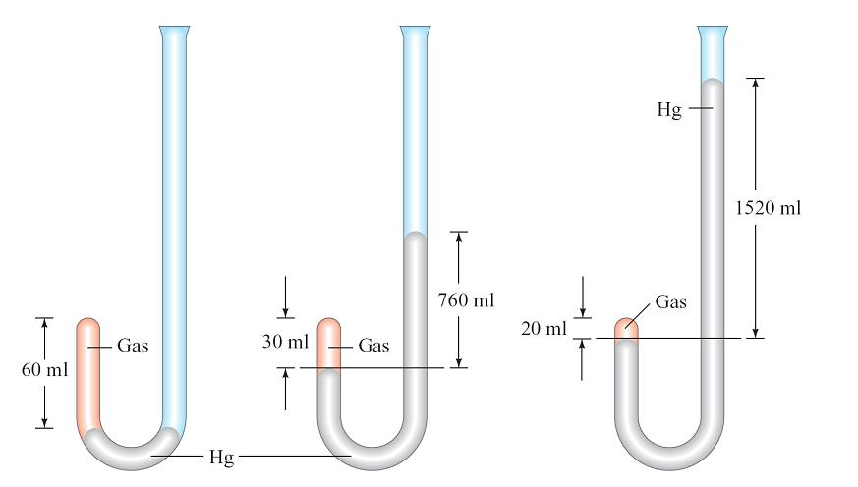
INVERSE VARIATION
In 1661, Robert Boyle made a study of the compressibility of gases. Figure 1.19 shows that he used a J-shaped tube to demonstrate the inverse relationship between the volume of a gas at a given temperature and the applied pressure.
Figure 1.19

Slide 20
INVERSE VARIATION
The J-shaped tube on the left in Figure 1.19 shows that the volume of a gas at normal atmospheric pressure is 60 milliliters.
If the pressure is doubled by adding mercury (Hg), as shown in the middle tube, the volume of the gas is halved to 30 milliliters.
Tripling the pressure decreases the volume of the gas to 20 milliliters, as shown in the tube at the right in Figure 1.19.

Slide 21
SOLVE AN INVERSE VARIATION
Boyle’s Law states that the volume V of a sample of gas (at a constant temperature) varies inversely as the pressure P. The volume of a gas in a J-shaped tube is 75 milliliters when the pressure is 1.5 atmospheres. Find the volume of the gas when the pressure is increased to 2.5 atmospheres.
Solution:
The volume V varies inversely as the pressure P, so

Slide 22
SOLUTION
cont’d
The volume V is 75 milliliters when the pressure is 1.5 atmospheres, so
and k = (75)(1.5) = 112.5
Thus

Slide 23
SOLUTION
cont’d
When the pressure is 2.5 atmospheres, we have
See Figure 1.20.
Figure 1.20

Slide 24
INVERSE VARIATION
Many real-world situations can be modeled by inverse variations that involve a power.
Definition of Inverse Variation as the nth Power
If y varies inversely as the nth power of x, then
where k is a constant and n > 0.

Slide 25
JOINT AND COMBINED VARIATIONS

Slide 26
JOINT AND COMBINED VARIATIONS
Some variations involve more than two variables.
Definition of Joint Variation
The variable z varies jointly as the variables x and y if and only if
z = kxy
where k is a constant.

Slide 27
SOLVE A JOINT VARIATION
The cost of insulating the ceiling of a house varies jointly as the thickness of the insulation and the area of the ceiling. It costs $175 to insulate a 2100-square-foot ceiling with insulation that is 4 inches thick. Find the cost of insulating a 2400-square-foot ceiling with insulation that is 6 inches thick.
Solution:
Because the cost C varies jointly as the area A of the ceiling and the thickness T of the insulation, we know
C = kAT.

Slide 28
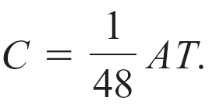
SOLUTION
cont’d
Using the fact that C = 175 when A = 2100 and T = 4
gives us
175 = k(2100)(4) which implies
Consequently, the specific formula for C is

Slide 29
SOLUTION
cont’d
Now, when A = 2400 and T = 6, we have
= 300
The cost of insulating the 2400-square-foot ceiling with 6-inch insulation is $300.

Slide 30
JOINT AND COMBINED VARIATIONS
Combined variations involve more than one type of variation.

Slide 31
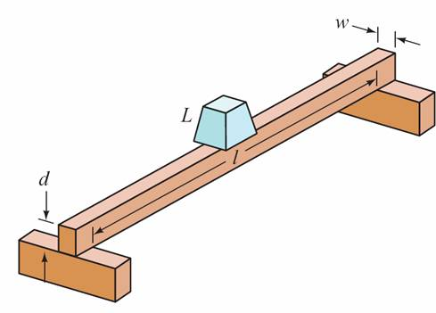
SOLVE A COMBINED VARIATION
The weight that a horizontal beam with a rectangular cross section can safely support varies jointly as the width and the square of the depth of the cross section and inversely as the length of the beam. See Figure 1.21.
If a 10-foot-long 4- by 4-inch beam safely supports a load of 256 pounds, what load L can be safely supported by a beam made of the same material and with a width w of 4 inches, a depth d of 6 inches, and a length l of 16 feet?
Figure 1.21

Slide 32
SOLUTION
The general variation equation is
Using the given data yields
Solving for k produces k = 40, so the specific formula for L
is

Slide 33

SOLUTION
Substituting 4 for w, 6 for d, and 16 for l gives

